Slide 1
Module 2
System Architecture & Agents Planning
Notes:
Exploring how AI agents revolutionize stock analysis

Slide 2
Understanding Tools for Agents
Tools are callable Python functions or APIs that agents invoke to fetch or compute data.
They act as the “hands” of the agent—performing real-world actions or fetching data the LLM cannot generate on its own.
Each tool encapsulates a specific function like fetching stock info, calculating indicators, or assessing risk.
Why Designing Tools Is Important?
Modularity & Accuracy: Tools separate logic from execution, ensuring reliable, verifiable, and efficient operations while minimizing hallucinations.
Reusability & Scalability: Well-designed tools are easy to extend, reuse across agents, and help maintain safety and control in complex workflows.
Notes:
When to Plan Agent Roles:
Before coding orchestration logic
When multiple skills/tools are involved
When output requires sequential reasoning or aggregation
During architecture design of multi-agent systems

Slide 3
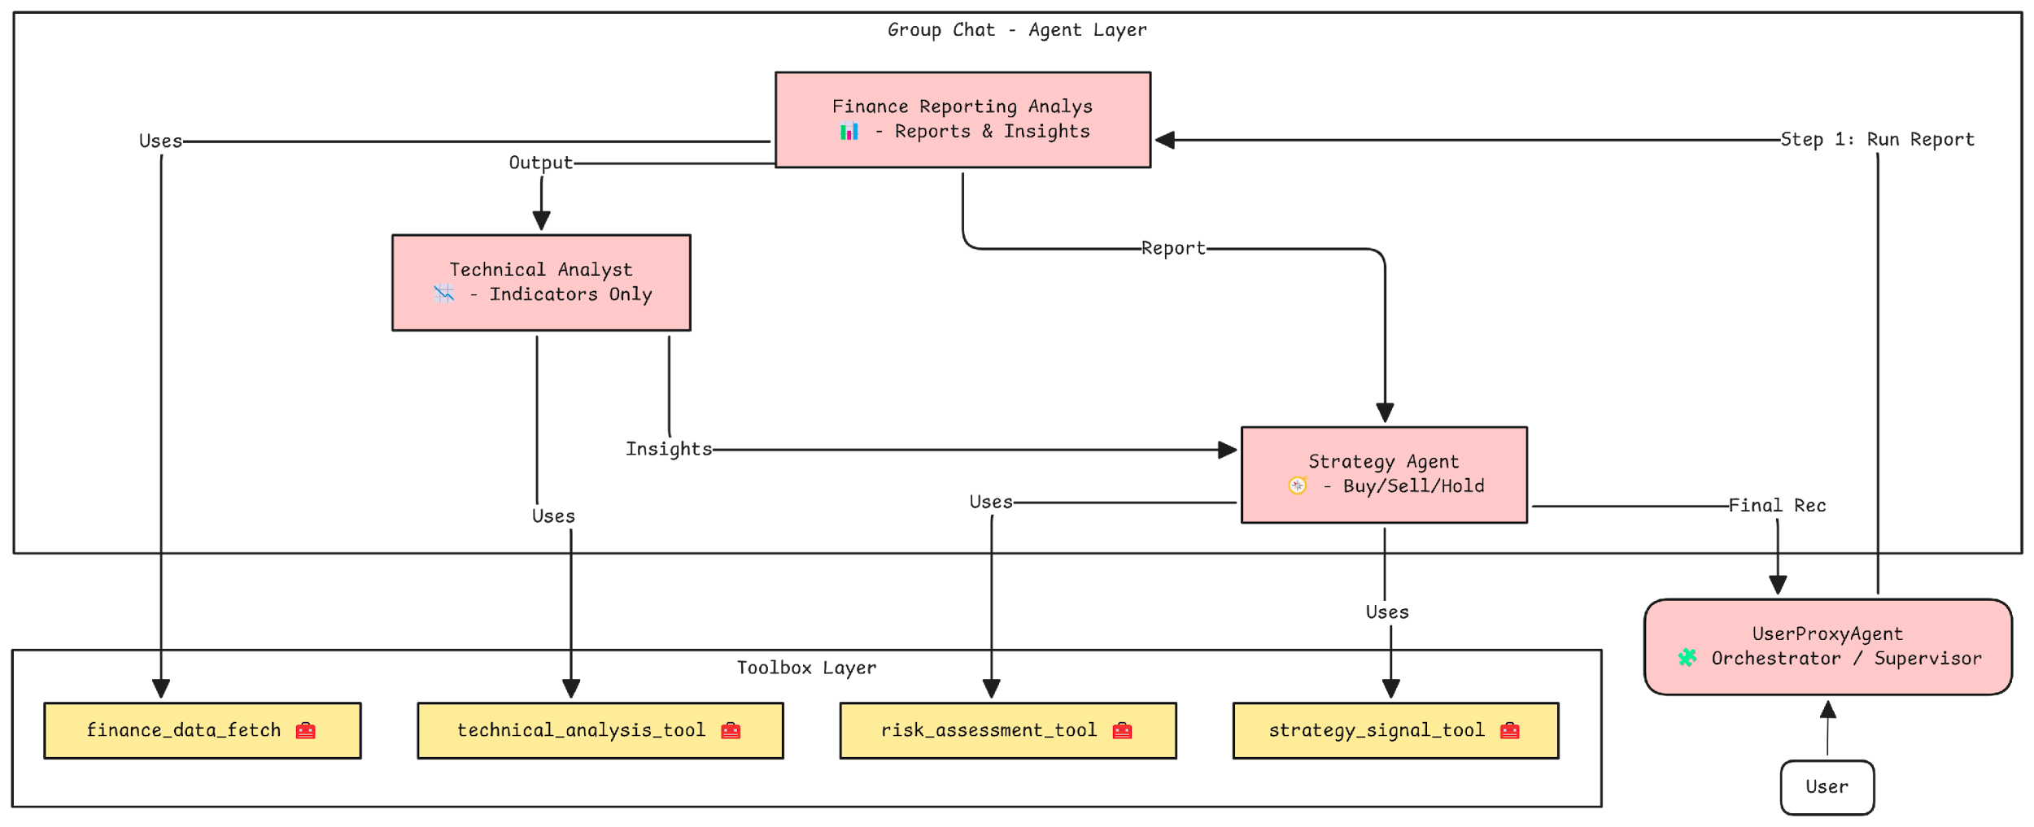
Agents and Tools for Financial Analysis

Slide 4
Tool 1: finance_data_fetch
Purpose: Fetch basic financial and historical stock data
Inputs: stock ticker, period (optional, default = 1mo)
Metrics Extracted:
Company info (name, market cap, price, ratios)
Historical closing prices
Used by: finance_reporting_analyst
Error Handling: Graceful fallback with error message in JSON
{
"name": "finance_data_fetch",
"data": {
"name": "Apple Inc.",
"symbol": "AAPL",
"currentPrice": 192.32,
"currency": "USD",
"summary": "Apple Inc. designs, manufactures, and markets smartphones, personal computers, tablets...",
"marketCap": 3000000000000,
"peRatio": 29.87,
"priceToBook": 45.3,
"dividend": 0.92,
"recentClosePrices": {
"2024-06-01": 189.50,
"2024-06-02": 190.40,
"2024-06-03": 191.70,
"2024-06-04": 192.32
}
}
}
Notes:
When to Plan Agent Roles:
Before coding orchestration logic
When multiple skills/tools are involved
When output requires sequential reasoning or aggregation
During architecture design of multi-agent systems

Slide 5
Tool 2: technical_analysis_tool
Purpose: Perform basic technical indicator calculations
Metrics Extracted:
SMA (Simple Moving Avg) – 20-day
EMA (Exponential Moving Avg) – 20-day
RSI (Relative Strength Index) – 14-day
Last close price
Used by: technical_analyst to detect trends and momentum
Error Handling: Graceful fallback with error message in JSON
{
"name": "technical_analysis_tool",
"data": {
"SMA_20": 188.45,
"EMA_20": 190.21,
"RSI": 62.8,
"Last_Close": 192.32
}
}
Notes:
When to Plan Agent Roles:
Before coding orchestration logic
When multiple skills/tools are involved
When output requires sequential reasoning or aggregation
During architecture design of multi-agent systems

Slide 6
Tool 3: risk_assessment_tool
Purpose: Analyze the stock’s risk profile
Metrics Extracted:
Beta (volatility)
Market Cap
Dividend Yield
52-week Change (Volatility proxy)
Risk Rating (High / Moderate / Low)
Used by: strategy_agent for risk-informed recommendations
Error Handling: Graceful fallback with error message in JSON
{
"name": "risk_assessment_tool",
"data": {
"Beta": 1.15,
"MarketCap": 3000000000000,
"DividendYield": 0.005,
"Volatility": 0.18,
"RiskRating": "Moderate"
}
}
Notes:
When to Plan Agent Roles:
Before coding orchestration logic
When multiple skills/tools are involved
When output requires sequential reasoning or aggregation
During architecture design of multi-agent systems

Slide 7
Tool 4:strategy_signal_tool
Purpose: Buy/Sell Signals - Support decision-making
Indicators Used:
MACD (Momentum)
MACD Signal Line
RSI
Last close price
Used by: strategy_agent for buy/sell/hold recommendations
Error Handling: Graceful fallback with error message in JSON
{
"name": "strategy_signal_tool",
"data": {
"MACD": 1.43,
"MACD_Signal": 1.12,
"RSI": 63.5,
"Last_Close": 192.32
}
}
Notes:
When to Plan Agent Roles:
Before coding orchestration logic
When multiple skills/tools are involved
When output requires sequential reasoning or aggregation
During architecture design of multi-agent systems

